Slide 1
EMS702UP Statistical Thinking and Applied Machine Learning
W3.2 Non-Parametric Testing
Jun Chen

Slide 2
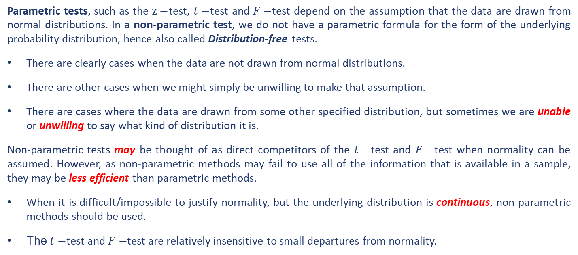
Introduction to Non-parametric Tests
Parametric tests, such as the $z−$test, $t−$test and $F−$test depend on the assumption that the data are drawn from normal distributions. In a non-parametric test, we do not have a parametric formula for the form of the underlying probability distribution, hence also called Distribution-free tests.
There are clearly cases when the data are not drawn from normal distributions.
There are other cases when we might simply be unwilling to make that assumption.
There are cases where the data are drawn from some other specified distribution, but sometimes we are unable or unwilling to say what kind of distribution it is.
Non-parametric tests may be thought of as direct competitors of the $t−$test and $F−$test when normality can be assumed. However, as non-parametric methods may fail to use all of the information that is available in a sample, they may be less efficient than parametric methods.
When it is difficult/impossible to justify normality, but the underlying distribution is continuous, non-parametric methods should be used.
The $t−$test and $F−$test are relatively insensitive to small departures from normality.

Slide 3

Non-parametric Methods – Tests for a Single Sample
The Sign Test
The sign test is used to test hypotheses concerning the median ($θ$) of a continuous distribution.
$H1:θ≠θ_{0}$
$$H0:θ=θ_{0} H1:θ>θ_{0}$$
$H1:θ<θ_{0}$
Suppose the sample taken from a population is $X_{1},X_{2}$, $X_{3},…,X_{n}$ and assume $H0$ is true, each difference $X_{i}−θ_{0}$ is equally likely to be positive or negative.
The above interpreted hypothesis test is equivalent to test the number of plus signs!!
The number of plus signs $\sim B(n, p)$ with $p=\frac{1}{2}$
Recall P-value $= P\left(data \right| hypothesis)$, in order to reject or accept a hypothesis, we compare the P-value with the chosen significance level. This can be done through calculating the probabilities directly from the binomial distribution or using the normal approximation to the binomial distribution.

Slide 4
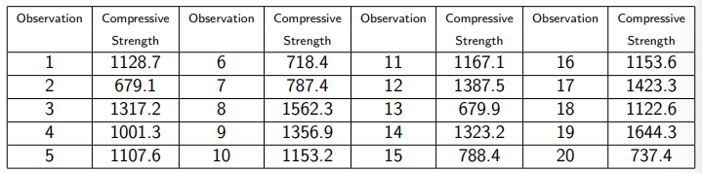
Non-parametric Methods – Tests for a Single Sample
The Sign Test
Example 1
The compressive strength of insulating blocks used in the construction of new houses is tested by a civil engineer. The engineer needs to be certain at the 5% level of significance that the median compressive strength is at least 1000 psi. Twenty randomly selected blocks give the following results:
Test (at the 5% level of significance) the null hypothesis that the median compressive strength of the insulting blocks is 1000 psi against the alternative that it is greater.
Solution

Slide 5
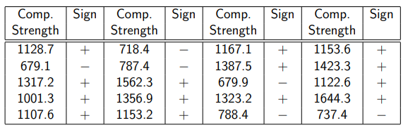
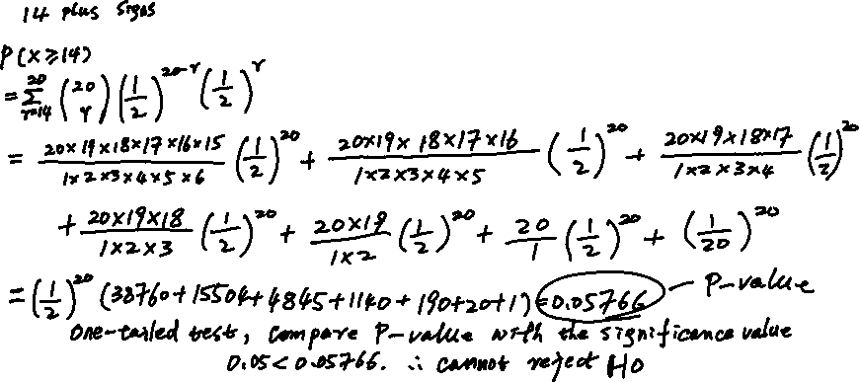
Non-parametric Methods – Tests for a Single Sample
Example 1 Continued…
Solution

Slide 6
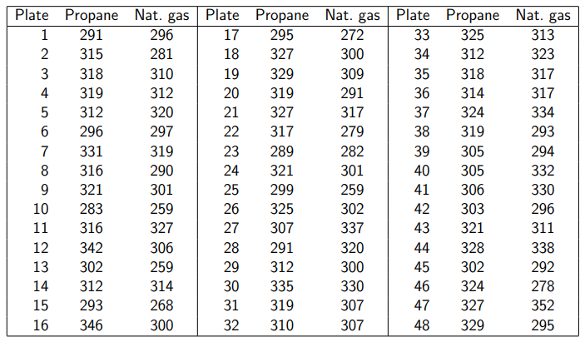

Non-parametric Methods – Tests for a Single Sample
The sign test for paired data
Example 2
In an experiment concerning gas cutting of steel for use in off-shore structures, 48 test plates were prepared. Each plate was cut using both oxy-propane cutting and oxy-natural gas cutting and, in each case, the maximum Vickers hardness near the cut edge was measured. The results were as follows.
Use a sign test to test the null hypothesis that the median difference between the hardnesses produced by the two methods is zero against the alternative that it is not zero. Use the 1% level of significance.
Solution

Slide 7
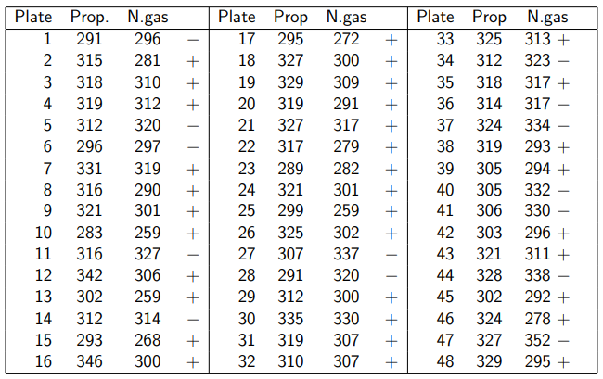
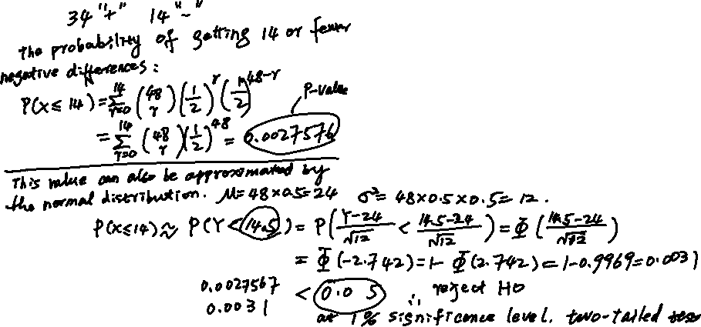
Non-parametric Methods – Tests for a Single Sample
Example 2 Continued…
Solution

Slide 8
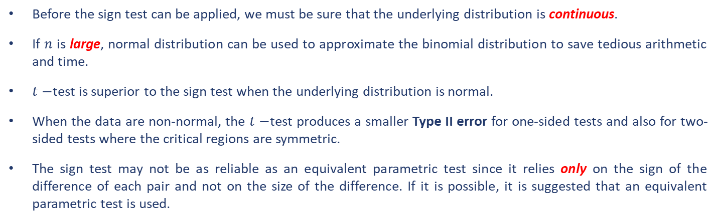
Non-parametric Methods – Tests for a Single Sample
Before the sign test can be applied, we must be sure that the underlying distribution is continuous.
If $n$ is large, normal distribution can be used to approximate the binomial distribution to save tedious arithmetic and time.
$t−$test is superior to the sign test when the underlying distribution is normal.
When the data are non-normal, the $t−$test produces a smaller Type II error for one-sided tests and also for two-sided tests where the critical regions are symmetric.
The sign test may not be as reliable as an equivalent parametric test since it relies only on the sign of the difference of each pair and not on the size of the difference. If it is possible, it is suggested that an equivalent parametric test is used.
Ties (i.e., 0 in difference) as the results of calculating signs should be discounted or counted as minus signs.

Slide 9
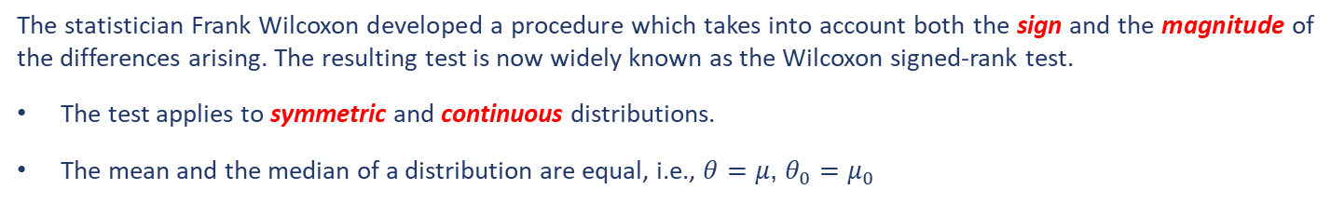
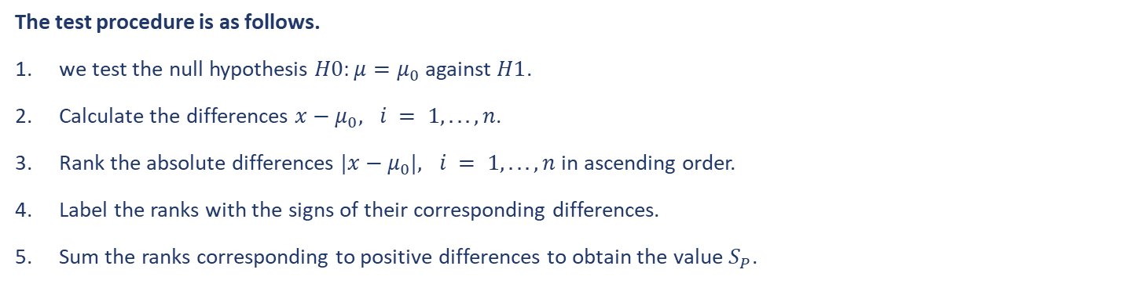
Non-parametric Methods – Tests for a Single Sample
The Wilcoxon signed-rank test
The statistician Frank Wilcoxon developed a procedure which takes into account both the sign and the magnitude of the differences arising. The resulting test is now widely known as the Wilcoxon signed-rank test.
The test applies to symmetric and continuous distributions.
The mean and the median of a distribution are equal, i.e., $θ=μ$, $θ_{0}=μ_{0}$
The test procedure is as follows.
we test the null hypothesis $H0:μ=μ_{0}$ against $H1$.
Calculate the differences $x−μ_{0}, i = 1, . . . , n$.
Rank the absolute differences $|x−μ_{0}|, i = 1, . . . , n$in ascending order.
Label the ranks with the signs of their corresponding differences.
Sum the ranks corresponding to positive differences to obtain the value $S_{P}$.

Slide 10
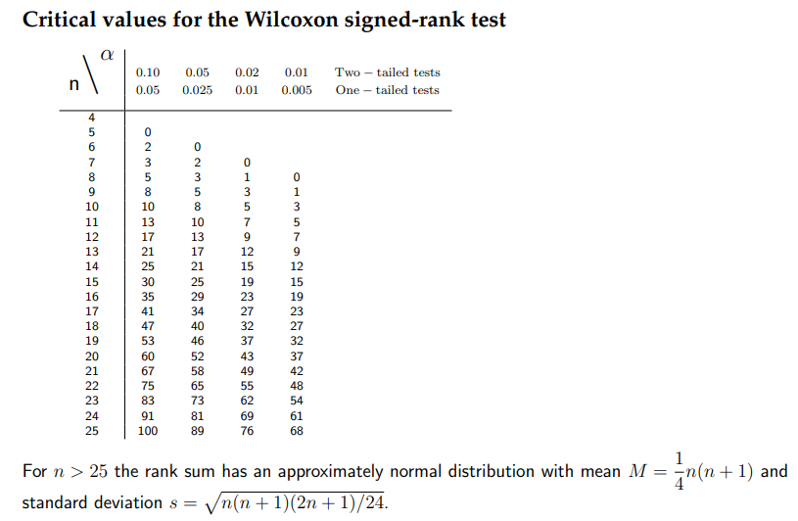
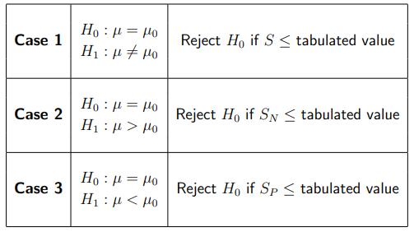
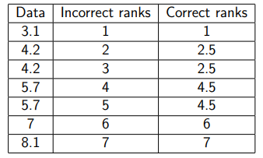
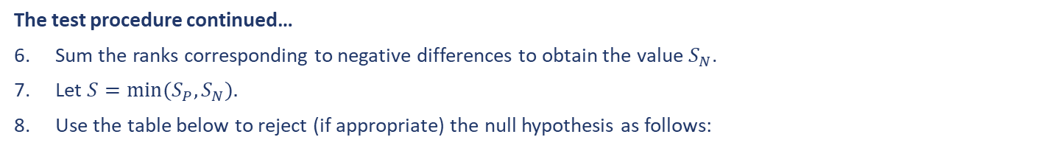
Non-parametric Methods – Tests for a Single Sample
The Wilcoxon signed-rank test
The test procedure continued…
Sum the ranks corresponding to negative differences to obtain the value $S_{N}$.
Let $S=min⁡(S_{P},S_{N}).$
Use the table below to reject (if appropriate) the null hypothesis as follows:

Slide 11
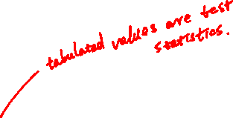
Non-parametric Methods – Tests for a Single Sample
The Wilcoxon signed-rank test
The test procedure continued…
Sum the ranks corresponding to negative differences to obtain the value $S_{N}$.
Let $S=min⁡(S_{P},S_{N}).$
Use the table below to reject (if appropriate) the null hypothesis as follows:

Slide 12
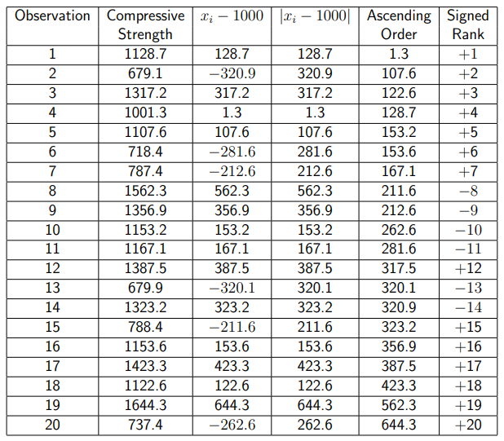
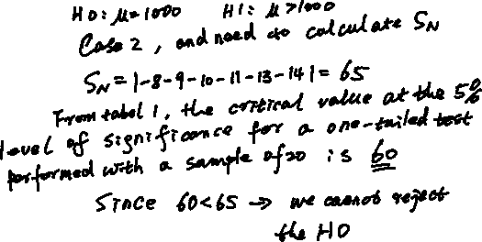
Non-parametric Methods – Tests for a Single Sample
Example 3
Use the Wilcoxon signed-rank test to decide (at the 5% level of significance) whether the hypothesis in Example 1 that the median compressive strength of the insulating blocks is at least 1000 psi is acceptable.
Solution

Slide 13
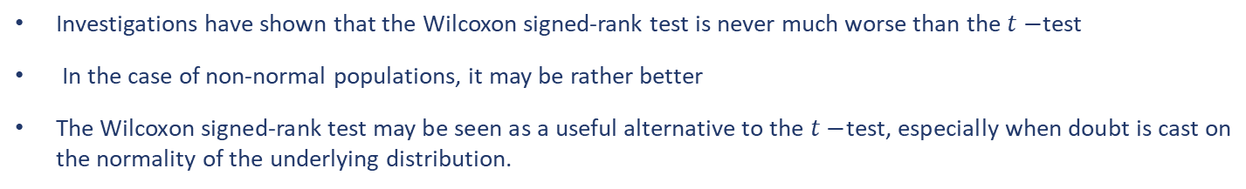
Non-parametric Methods – Tests for a Single Sample
The Wilcoxon signed-rank test
Investigations have shown that the Wilcoxon signed-rank test is never much worse than the $t−$test
In the case of non-normal populations, it may be rather better
The Wilcoxon signed-rank test may be seen as a useful alternative to the $t−$test, especially when doubt is cast on the normality of the underlying distribution.

Slide 14
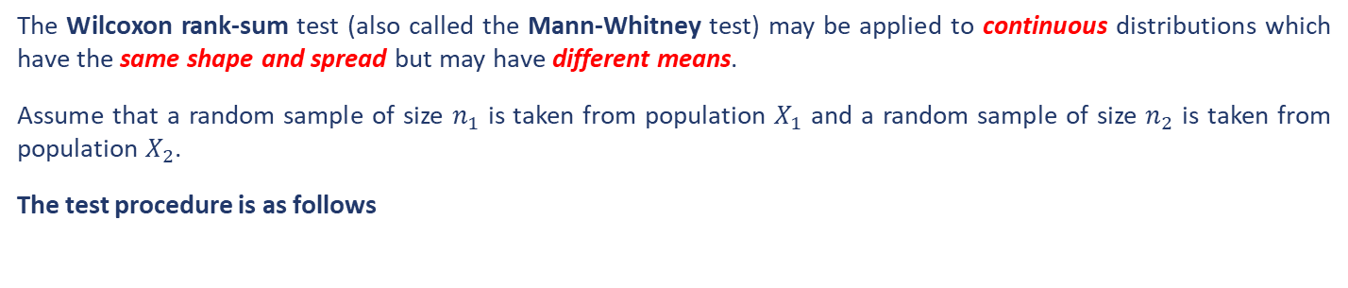
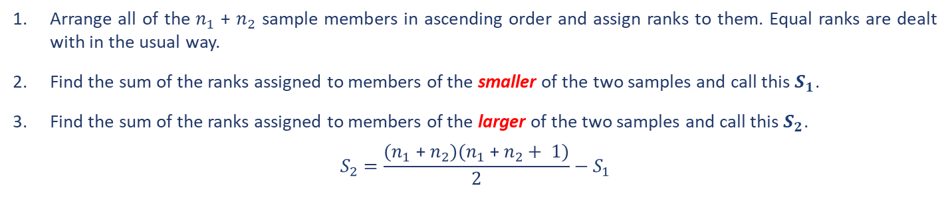
Non-parametric Methods – Tests for Multiple Samples
The Wilcoxon rank-sum test
The Wilcoxon rank-sum test (also called the Mann-Whitney test) may be applied to continuous distributions which have the same shape and spread but may have different means.
Assume that a random sample of size $n_{1}$ is taken from population $X_{1}$ and a random sample of size $n_{2}$ is taken from population $X_{2}$.
The test procedure is as follows
Arrange all of the $n_{1}$ + $n_{2}$ sample members in ascending order and assign ranks to them. Equal ranks are dealt with in the usual way.
Find the sum of the ranks assigned to members of the smaller of the two samples and call this $S_{1}$.
Find the sum of the ranks assigned to members of the larger of the two samples and call this $S_{2}$.
$$S_{2}=\frac{{(n}_{1}\text{ + }n_{2})(n_{1}\text{ + }n_{2}+ 1)}{2}−S_{1}$$

Slide 15
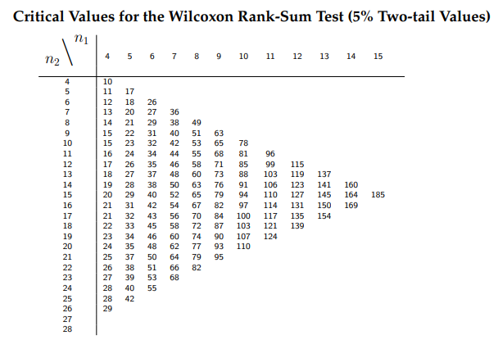
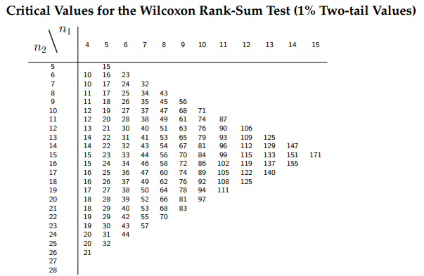
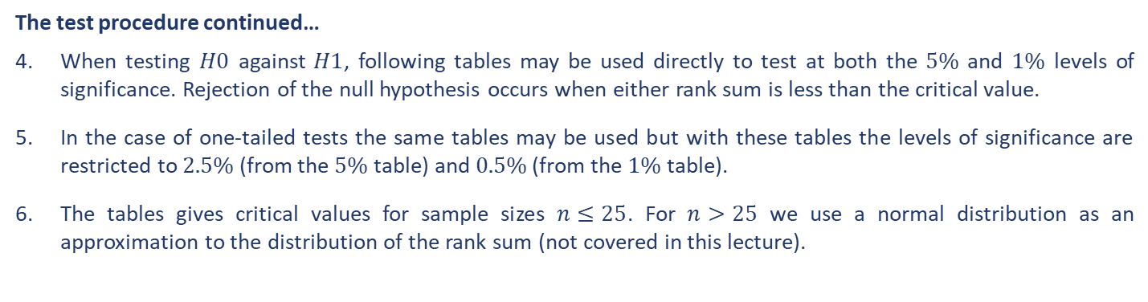
Non-parametric Methods – Tests for Multiple Samples
The test procedure continued…
When testing $H0$ against $H1$, following tables may be used directly to test at both the $5\%$ and $1\%$ levels of significance. Rejection of the null hypothesis occurs when either rank sum is less than the critical value.
In the case of one-tailed tests the same tables may be used but with these tables the levels of significance are restricted to $2.5\%$ (from the $5\%$ table) and $0.5\%$ (from the $1\%$ table).
The tables gives critical values for sample sizes $n≤25$. For $n>25$ we use a normal distribution as an approximation to the distribution of the rank sum (not covered in this lecture).

Slide 16
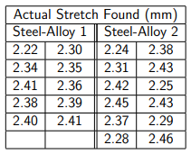
Non-parametric Methods – Tests for Multiple Samples
Example 4
A motorcycle engineer is investigating the resistance to stretching of two alloy steels for potential use in chains. The engineer wishes to establish in the first instance whether there is any difference in the mean resistance to stretch of the two alloys. 10 samples of one alloy and 12 samples of the second alloy are tested under the same conditions and the actual stretch is measured. All samples are the same length. The results are given in the table below.
Use the Wilcoxon rank-sum test to decide, at the 5% level of significance, whether there is evidence of a significant difference in the mean resistance to stretching of the two alloys.
Solution

Slide 17
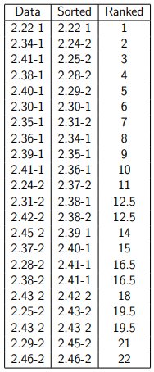
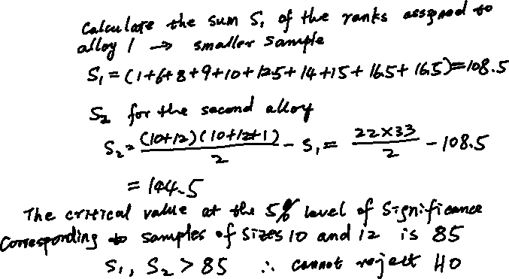
Non-parametric Methods – Tests for Multiple Samples
Example 4 Continued…
Solution

Slide 18
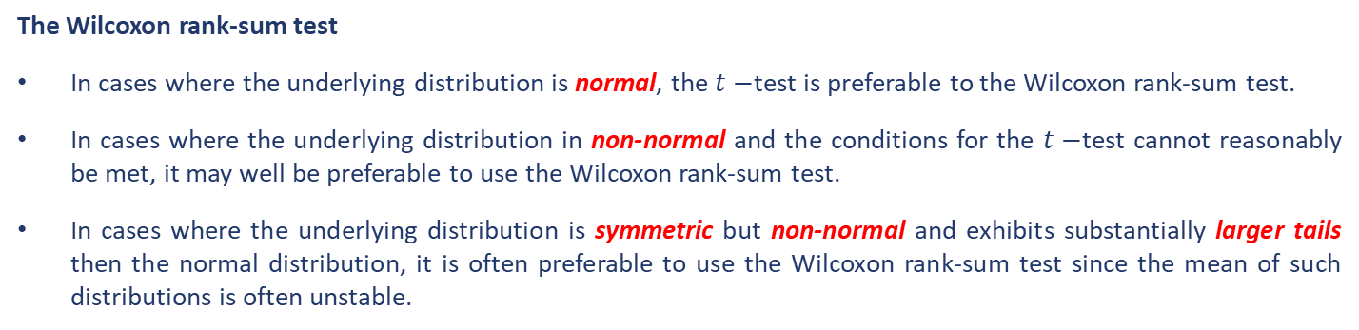
Non-parametric Methods – Tests for Multiple Samples
The Wilcoxon rank-sum test
In cases where the underlying distribution is normal, the $t−$test is preferable to the Wilcoxon rank-sum test.
In cases where the underlying distribution in non-normal and the conditions for the $t−$test cannot reasonably be met, it may well be preferable to use the Wilcoxon rank-sum test.
In cases where the underlying distribution is symmetric but non-normal and exhibits substantially larger tails then the normal distribution, it is often preferable to use the Wilcoxon rank-sum test since the mean of such distributions is often unstable.

Slide 19
End slide

